Slide 1

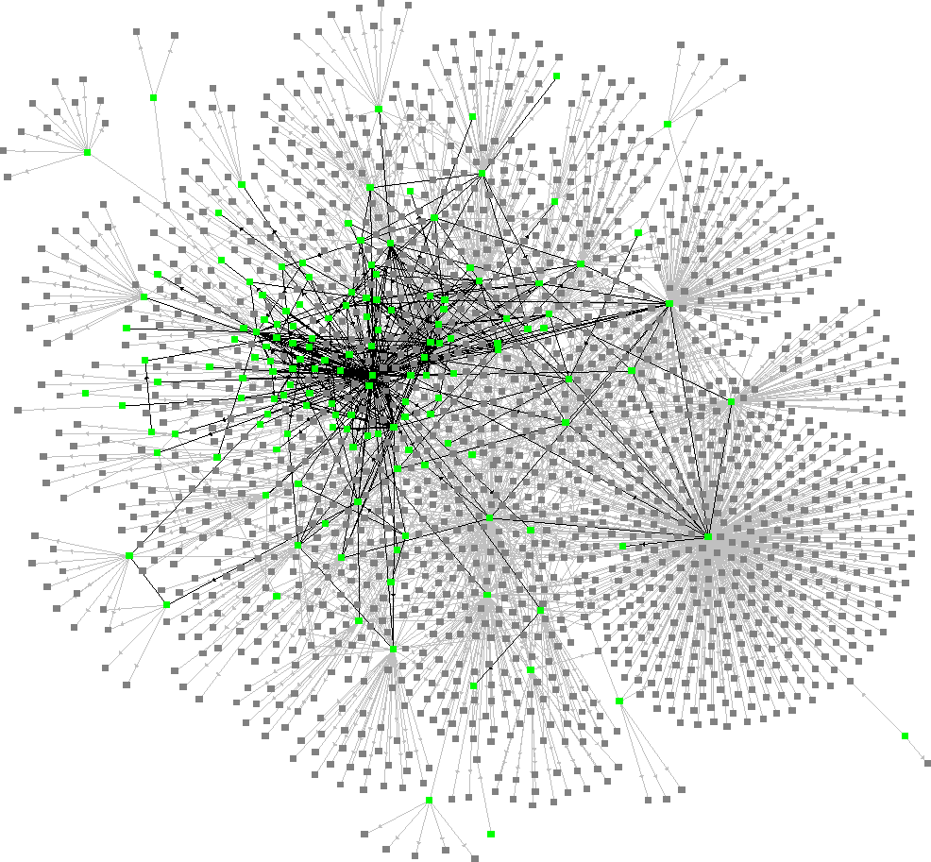
Data Structures 資料結構
Graphs – Part I
Image courtesy of www.escpeuropealumni.org
Department of Computer Science
National Tsing Hua University
Image courtesy of Ross Mayfield

Slide 2
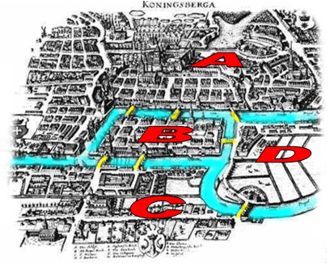
Konigsberg Bridge Problem
4 lands
7 bridges
Problem:
Starting at one land, is it possible to walk across all the bridges exactly once and returning to the starting land?

Slide 3
Konigsberg Bridge Problem
Euler formulate the problem as a graph.
Prove that the answer to the problem is possible iff the degree of each vertex is even.
A
B
D
C

Slide 4
Graph Definition
A graph, G, consists of two sets, V and E.
G = (V, E)
V : a set of vertices.
E : a set of pairs of vertices called edges.
Undirected graph (simply graph)
(u,v) and (v,u) represent the same edge.
Directed graph (digraph)
<u,v> ≠ <v,u>
<u,v> => u is tail and v is head of edge.

Slide 5
Examples
0
0
0
1
2
1
1
2
3
3
4
5
6
2
Undirected Graph
V(G)={0, 1, 2, 3} E(G)={(0,1), (0,2), (0,3), (1,2), (1,3), (2,3)}
Undirected Graph
V(G)={0, 1, 2, 3, 4, 5, 6} E(G)={(0,1), (0,2), (1,3), (1,4), (2,5), (2,6)}
Directed Graph
V(G)={0, 1, 2} E(G)={<0,1>, <1,0>, <1,2>)}

Slide 6
Restrictions
Self edges and self loops are not permitted!
Edges of the form (v, v) and <v, v> are not legal.
A graph may not have multiple occurrences of the same edge (multigraph).
0
0
1
3
1
3
2
2
Graph with self edge
Multigraph

Slide 7
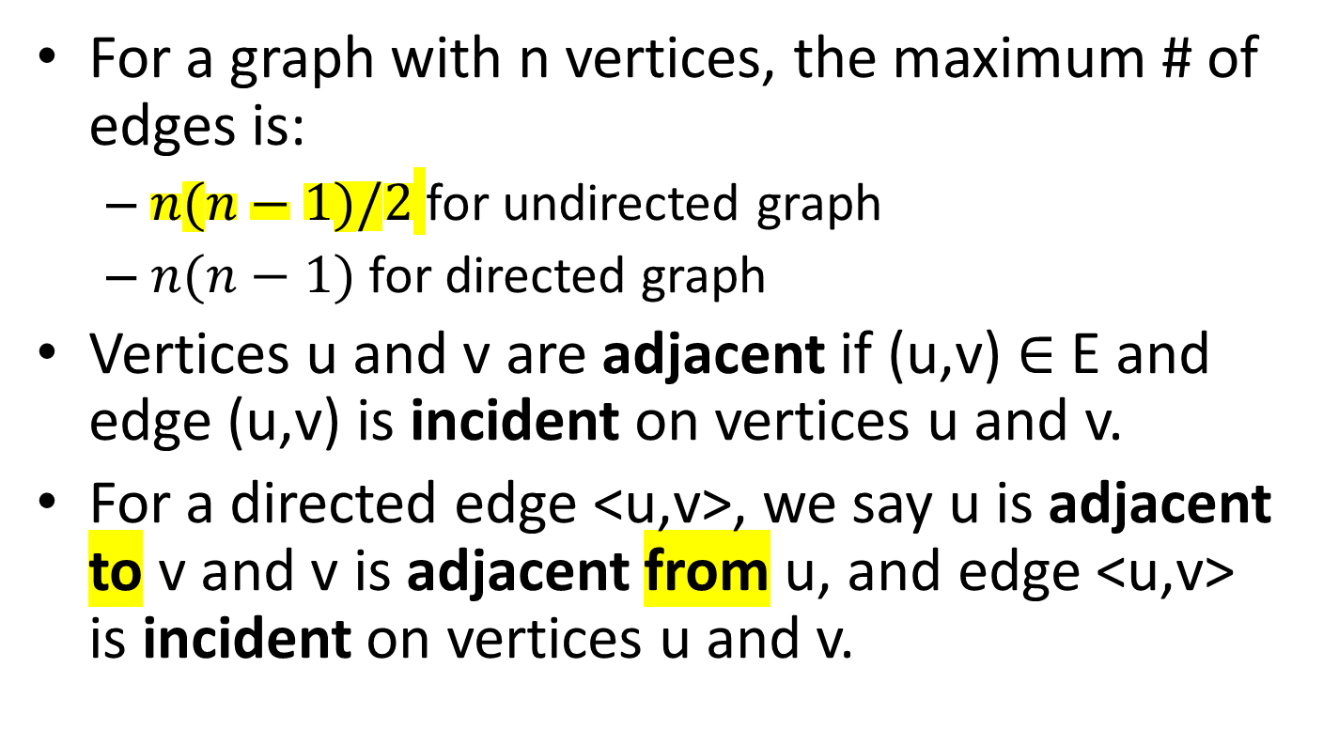
Terminology
For a graph with n vertices, the maximum # of edges is:
$n(n−1)/2$ for undirected graph
$n(n−1)$ for directed graph
Vertices u and v are adjacent if (u,v) $∈$ E and edge (u,v) is incident on vertices u and v.
For a directed edge <u,v>, we say u is adjacent to v and v is adjacent from u, and edge <u,v> is incident on vertices u and v.

Slide 8


Terminology
Complete undirected graph
Complete directed graph
Graph with n vertices has exactly $n(n−1)/2$ edges.
Graph with n vertices has exactly $n(n−1)$ edges.
0
0
1
2
1
2
3

Slide 9
Terminology
Subgraph:
G’ is a subgraph of G such that V(G’) ⊆ V(G) and E(G’) ⊆ E(G).
0
0
1
2
1
2
1
2
3
3
3
Graph
Subgraph
Subgraph

Slide 10
Terminology
Path:
A path from u to v represents a sequence of vertices u,i₁ ,i₂ ,…,i_{k} , v such that (u, i₁), (i₁ ,i₂),…, (i_{k} ,v) are edges in graph.
Simple path:
A simple path is a path in which all vertices except possibly the first and the last are distinct.
0
Sequence | Path? | Simple path?
0,1,3,2
0,2,0,1
0,3,2,1
1
2
Yes Yes
Yes No
3
No No

Slide 11
Terminology
Cycle:
A cycle is a simple path which the first and the last vertices are the same.
Notes: if the graph is a directed graph, we usually add the prefix “directed” to above terms:
Directed path
Directed simple path
Directed cycle

Slide 12
Terminology
每個不同的點之間都有path
Undirected graph G is said to be connected iff for every pair of distinct vertices u and v, there is a path from u to v in G.
0
0
4
1
2
1
2
5
7
3
3
6
Connected graph
Not a connected graph

Slide 13
Terminology
A connected component, H, of an undirected graph is a maximal connected subgraph.
Tree:
A connected acyclic graph.
0
4
1
2
5
7
3
6
H₁
H₂
Graph with two connected components

Slide 14
Terminology
Directed graph G is said to be strongly connected iff for every pair of distinct vertices u and v, there is a directed path from u to v and also from v to u in G.
0
Not a strongly connected digraph!
There is no directed path from 2 to 0
1
2

Slide 15
Terminology
A strongly connected component is a maximal subgraph that is strongly connected.
0
0
1
2
1
2
H₁
H₂
Two strongly connected components

Slide 16
Terminology
Degree of a vertex v:
The # of edges incident to v.
In a directed graph:
In-degree of v
The # of edges for which v is the head.
Out-degree of v
The # of edges for which v is the tail.
Degree of v = in-degree + out-degree

Slide 17
Self-Study Topics – some variations to Konigsberg Bridge Problem
4 lands
7 bridges
Problem:
Original Problem:
Starting at one land, is it possible to walk across all the bridges exactly once and returning to the starting land?

Slide 18
Konigsberg Bridge Problem
Euler formulate the problem as a graph.
Prove that the answer to the problem is possible iff the degree of each vertex is even.
A
B
D
C

Slide 19
What if the degrees are not all even? (Self-Study)
Only a pair of vertices with odd degree
Multiple pairs of odd-degree vertices Chinese Postman Problem (中國郵差問題)
A
B
D
C
A
B
D
C

Slide 20
Graph representation

Slide 21
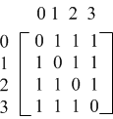

Adjacency Matrix
A two dimensional array with the property that a[i][j] = 1 iff the edge (i,j) or <i,j> is in E(G).
Waste of memory when a graph is sparse
Storage O(n²)
0
0
1
2
1
3
2

Slide 22
Adjacency Lists
Undirected graph: Use a chain to represent each vertex and its adjacent vertices.
adjLists
0
[0]
3
1
2
0
1
2
[1]
2
3
0
0
[2]
1
3
0
0
3
[3]
0
1
2
0

Slide 23
Adjacency Lists
Directed graph: Use a chain to represent each vertex and its adjacent to vertices.
Length of list = Out-degree of v
0
adjLists
[0]
1
0
1
[1]
2
0
0
2
[2]
NULL

Slide 24
Inverse Adjacency Lists
Directed graph: Use a chain to represent each vertex and its adjacent from vertices
Length of list = In-degree of v
0
adjLists
[0]
1
0
1
[1]
0
0
2
[2]
1
0

Slide 25
Weighted Edges
Edges of a graph sometimes have weights associated with them.
Distance from one vertex to another.
Cost of going from one vertex to an adjacent vertex.
We use additional field in each edge to store the weight.
A graph with weighted edges is called a network.

Slide 26
ADT: Graph
class Graph {// object: A nonempty set of vertices and a set of undirected edges. public: virtual ~Graph() {} // virtual destructor bool IsEmpty() const{return n == 0}; // return true iff graph has no vertices int NumberOfVertices() const{return n}; // return the # of vertices int NumberOfEdges() const{return e}; // return the # of edges virtual int Degree(int u) const = 0; // return the degree of a vertex virtual bool ExistsEdge(int u, int v) const = 0; // check the existence of edge virtual void InsertVertex(int v) = 0; // insert a vertex v virtual void InsertEdge(int u, int v) = 0; // insert an edge (u, v) virtual void DeleteVertex(int v) = 0; // delete a vertex v virtual void DeleteEdge(int u, int v) = 0; // delete an edge (u, v) // More graph operations… protected: int n; // number of vertices int e; // number of edges };

Slide 27
Implementation Notes
To accommodate various graph types, we make the following assumptions:
Data type of edge weight is double (or represented as a template parameter).
We define operations which are independent of specific graph representation in the Graph.
We assume the iterator is used to visit adjacent vertices.

Slide 28
Example: LinkedGraph
void Graph::foo(void){ // use iterator to visit adjacent vertices of v for (each vertex w adjacent to v)… }
class LinkedGraph : public Graph { public: // constructor LinkedGraph(const int vertices = 0) : n(vertices), e(0){ adjLists = new Chain<int>[n]; } // more customized operations… private: Chain<int> *adjLists // adjacency lists };

Slide 29
Elementary Graph operations

Slide 30

Graph Operations
Graph traversal
Depth-first search
Breadth-first search
Connected components
Spanning trees

Slide 31
Depth-First Search (DFS)
Starting from a vertex v
Visit the vertex v => DFS(v).
For each vertex w adjacent to v, if w is not visited yet, then visit w => DFS(w).
If a vertex u is reached such that all its adjacent vertices have been visited, we go back to the last visited vertex.
The search terminates when no unvisited vertex can be reached from any of the visited vertices.

Slide 32
Depth-First Search (DFS)
0
0
1
3
7
1
2
4
5
2
6
3
4
5
6
Note that the output order is not unique, there are other possibilities, depending on the graph representation
7

Slide 33
Recursive DFS
void Graph::DFS(void){ visited = new bool[n]; // this is a data member of Graph fill(visited, visited+n, false); DFS(0); // start search at vertex 0 delete [] visited; } void Graph::DFS(const int v){ // visit all previously unvisited vertices that are adjacent to v output(v); visited[v]=true; for(each vertex w adjacent to v) if(!visited[w]) DFS(w); }

Slide 34
Non-Recursive DFS
void Graph::DFS(int v){ visited = new bool[n]; // this is a data member of Graph fill(visited, visited+n, false); Stack<int> s; // declare and init a stack s.Push(v); while(!s.IsEmpty()){ v = s.Top(); s.Pop(); if(!visited[v]){ output(v); visited[v]=true; for(each vertex w adjacent to v) if(!visited[w]) s.Push(w); } } }

Slide 35
DFS Complexity
Adjacency matrix
Time to determine all adjacent vertices: O(n)
At most n vertices are visited: O(n∙n) = O(n²)
Adjacency lists
There are n+2e chain nodes
Each node in the adjacency lists is examined at most once. Time complexity = O(e)

Slide 36
Trees and DFS
Inorder, preorder and postorder traversal can be viewed as specialized DFS
They differ from each other on when the key is printed
If tree is represented with linked nodes
The time complexity of in-, pre-, post-orders are O(n)
Since in trees, |E|=n-1
The same time complexity as DFS

Slide 37
Breadth-First Search (BFS)
Starting from a vertex v
Visit the vertex v.
Visit all unvisited vertices adjacent to v.
Unvisited vertices adjacent to these newly visited vertices are then visited and so on…

Slide 38
Breadth-First Search (BFS)
0
0
1
2
3
1
2
4
5
6
7
3
4
5
6
Note that the output order is not unique, there are other possibilities, depending on the graph representation
7

Slide 39
BFS: Implementation
void Graph::BFS(int v){ visited = new bool[n]; // this is a data member of Graph fill(visited, visited+n, false); Queue<int> q; // declare and init a queue q.Push(v); visited[v]=true; while(!q.IsEmpty()){ v = q.Front(); q.Pop(); output(v); for(each vertex w adjacent to v){ if(!visited[w]){ q.Push(w); visited[w]=true; } } } delete [] visited; }
Time complexity is the same as DFS

Slide 40
Trees and BFS
BFS looks familiar, right?
Level-order traversal is a specialized BFS
Visiting order from left to right

Slide 41
Connected Components
How to determine whether a graph is connected or not?
Call DFS or BFS once and check if there is any unvisited vertices, if Yes, then the graph is not connected.
How to identify connected components
Call DFS or BFS repeatly.
Each call will output a connected component.
Start next call at an unvisited vertex.

Slide 42
Spanning Trees
Definition: Any tree consists of solely of edges in E(G) and including all vertices of V(G).
Number of tree edges is n-1.
Add a non-tree edge will create a cycle.
0
0
0
0
1
2
1
2
1
2
1
2
3
3
3
3
Complete graph
Possible spanning trees

Slide 43
DFS Spanning Tree
Tree edges are those edges met during the traversal.
0
1
3
7
0
0
4
5
2
6
1
2
1
2
DFS
3
4
5
6
3
4
5
6
7
7

Slide 44
BFS Spanning Tree
Tree edges are those edges met during the traversal.
0
1
2
3
0
0
4
5
6
7
1
2
1
2
BFS
3
4
5
6
3
4
5
6
7
7

